Slide 1





Welcome to Podar Jumbo Kids
Parent Induction 2020-21

Slide 2
NURTURING CHILDREN SINCE 2000
More than 490 CENTRES
IN MORE THAN 25 STATES IN INDIA
Total- 455,000 children in PJK
3 centers in UAE- Dubai-Sharjah

Slide 3




Trust Deed Signed by The First President of Podar Education Network :Mahatma Gandhi

Slide 4









Kiducation Philosophy
Head
=
Thinking
=
Creating & Thinking
Critically
Infusion of philosophers and educationists around the world into our kiducation based curriculum
Heart
=
Nurturing
=
Motivation
=
Active Learning
Hands
=
Stimulation
+
Physical Engagement
=
Playing & Exploring
Kiducation is the core educational belief and means education from the point of view of the child’s development .

Slide 5


Components at Podar Jumbo Kids
Nursery
Junior KG
Playgroup
Senior KG
Born Smart
(A Unique Mother
Toddler Programme)
Daycare

Slide 6




Early Year Foundation Stage (EYFS)
Podar Jumbo Kids, the only Kindergarten chain in India to implement the Early Years Foundation Stage curriculum and
assessment of British curriculum - EYFS

Slide 7



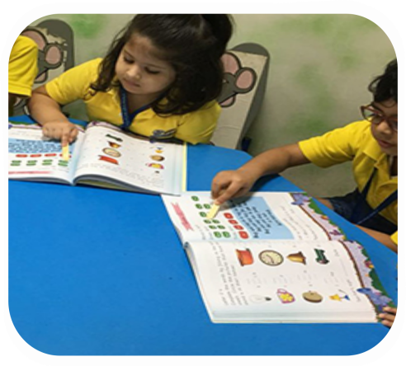

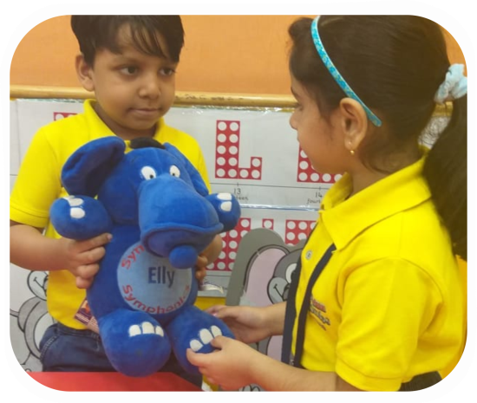
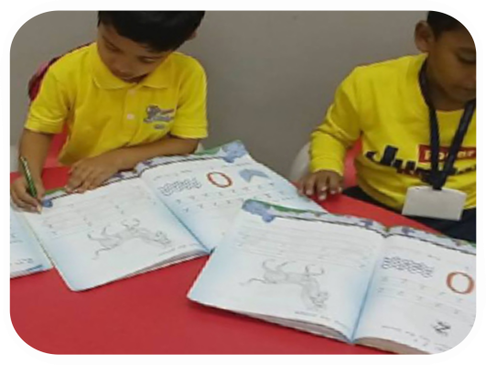


The Reading and Writing Program Unique Curriculum Features: Symphonics-
Symphonics is an in-house researched and developed phonics program. It focuses on reading and writing, integrating phonics methodology into learning to read, write and spell words easily and efficiently
So while other
schools teach kids
A to Z and maybe
phonics
It aims at enhancing reading skills in children at an early age by developing a strong foundation of English Language in a scientific, structured and systematic way.

Slide 8
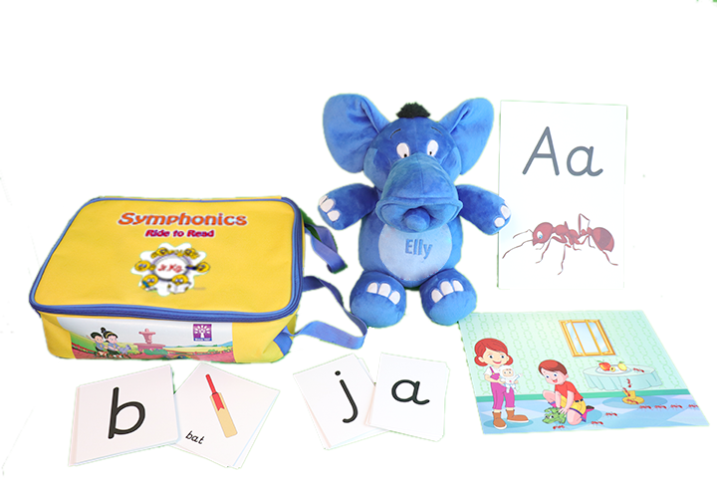
Symphonics Teaching Resources

Slide 9
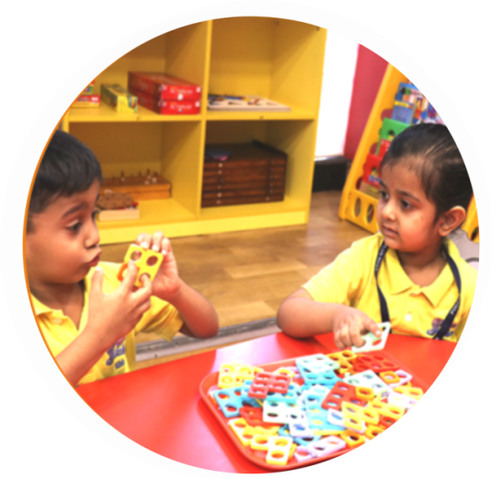
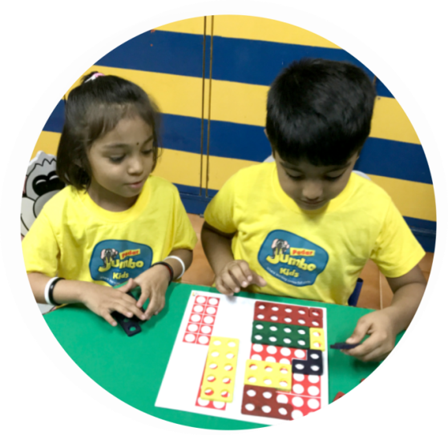
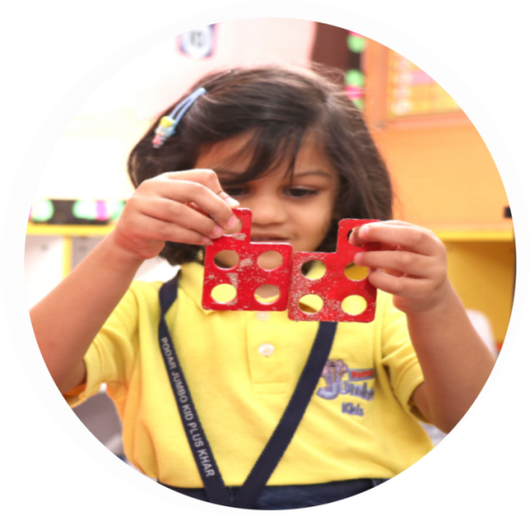
Unique Curriculum Features:
Number Magic –
Math Education Program
Number Magic actively engages children both physically and mentally through Mathematics activities and games.
It is a multisensory approach to develop math skills and enables children to understand math concepts through the use of effective teaching resources.

Slide 10

Unique Curriculum Features:
Number Magic –
Math Education Program
Notes:
Not only do they love children but are patient ,warm and dedicated too .Every child is greeted with a smile .

Slide 11
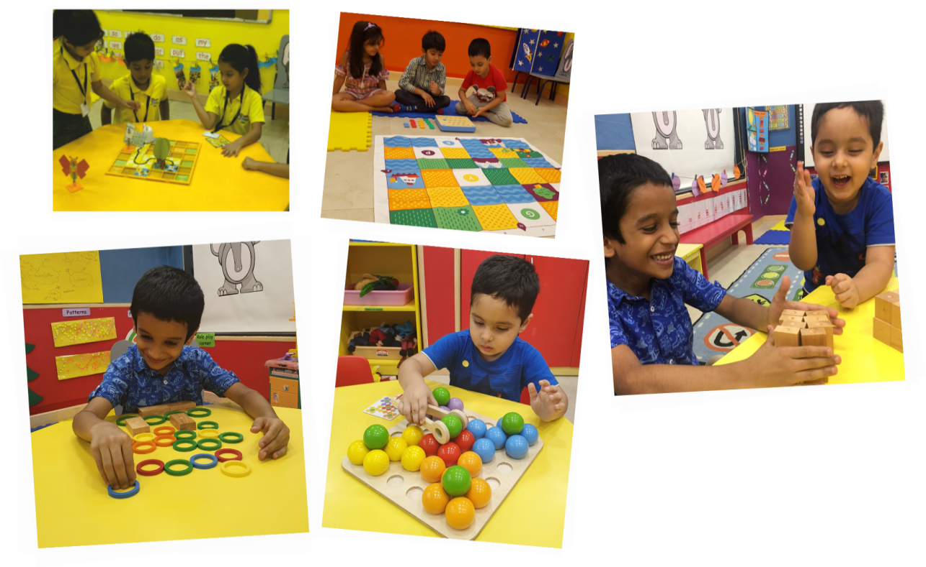
Coding and Robotics
Podar Jumbo Kids is proud to be the only kindergarten in the world with
Coding and Robotics in the Early Years.
We forget to teach children about ‘technology’ around them. It is time for
technology literacy with Jumbo.
Notes:
The curriculum is designed to encourage learning outcomes that focus on nurturing children to develop holistically,
& academic skills like personal social development ,literacy, numeracy ,understanding my world ,physical skills etc with assessments done at each stage on every area of learning.

Slide 12


Slide 13
All about Podar Jumbo Kids
Admission Kit, Uniforms
and
Child ID card.
Notes:
Not only do they love children but are patient ,warm and dedicated too .Every child is greeted with a smile .

Slide 14
Dear Parents,
Safe and Happy Greetings from Podar Jumbo Kids.
We would like to inform you on the process of ordering Podar Jumbo Kids essentials which will be required by your child. In this ppt we will detail out the process of ordering for your easy understanding.
Please study the next slides on the various topics and in case of any further query, please do get in touch with the Headmistress of the Podar Jumbo Kids Centre.
You may start placing your orders online and once the lockdown is lifted by the Government, the dispatch will be done on priority basis to ensure that the child is ready with the all essentials required at school.
Thanking you,
Warm Regards,
Name of Headmistress
Podar Jumbo Kids- Location
Contact Number
Email id

Slide 15
ADMISSION KIT ORDERING AT
PODAR JUMBO KIDS
TO BE ORDERED ON
www.shopforschool.in
Notes:
Not only do they love children but are patient ,warm and dedicated too .Every child is greeted with a smile .

Slide 16




LEVEL WISE ADMISSION KIT AT PODAR JUMBO KIDS
Playgroup
Nursery
Jr.KG
Sr.KG

Slide 17



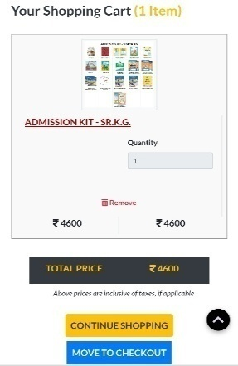
Steps to order Admission Kit from www.shopforschool.in
1. Log in to website shopforschool.in
3. Select the Level for which you need to order the admission kit for your child and place the order
2. Select the territory and Podar Jumbo Kids centre your child is enrolled in in order to place the order
4. Make the payment by using Net banking, Credit /Debit cards
Notes:
Not only do they love children but are patient ,warm and dedicated too .Every child is greeted with a smile .

Slide 18
ADMISSION KIT ITEMS TO BE SUBMITTED TO SCHOOL ON REOPENING
The admission kit received at your place on ordering will be 2 parts:
1.Parent Kit
2.Student Kit
The Parent Kit comprises of the Bag, Parent Smart Card and Passport .
The Student Kit comprises of the activity books, Portfolio Book, notebooks, workbooks etc as per the class the child is on.
Please submit the Student Kit to Podar Jumbo Kids centre once it reopens as those resources will be required at the centre to conduct the daily activities with the child.

Slide 19
UNIFORM ORDERING AT
PODAR JUMBO KIDS
Notes:
Not only do they love children but are patient ,warm and dedicated too .Every child is greeted with a smile .

Slide 20









Uniform and other Accessories at
Podar Jumbo Kids to be ordered online from our website www.shopforschool.in
Sweat Shirt
Track pant
Girls uniform
Cycling shorts
Cap
Floaters
Boys uniform

Slide 21

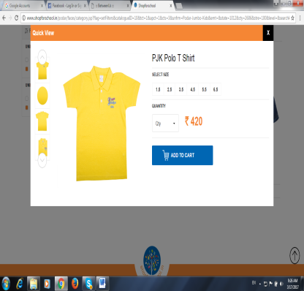

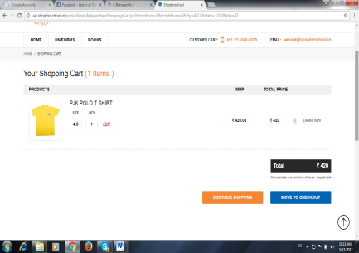
Steps to order Uniform and Accessories from www.shopforschool.in
1.Log in to website Shop for school .in
3.Select the size of the uniform and place the order
2.Select the territory and school your child is enrolled in in order to place the order
4.Make the payment by using Net banking ,Credit /Debit cards

Slide 22
STUDENT ID CARD DETAILS ON BETWEEN US APP
BY PARENTS

Slide 23
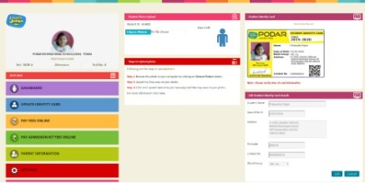
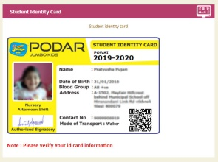
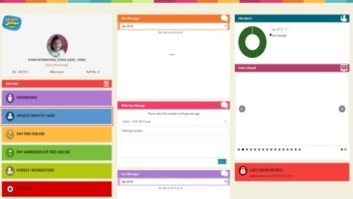
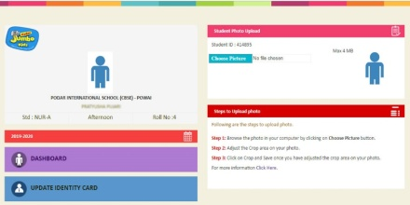
PROCESS TO FILL STUDENT ID CARD DETAILS ON
BETWEEN US APP TO BE DONE BY PARENTS
1.Login on to www.betweenus.in on the computer or log on to the app on your mobile phone.
3. Take a picture of your child in school uniform preferably and upload the photo of your child under Student Photo Upload panel.
5.Once updated you can check your details under Student Identity Card panel.
2.Click on Update Identity Card menu below Dashboard.
4.Click on Choose Picture option & browse through your computer/phone gallery. Select the photo for upload.
6. The details are now with the school and they would develop the physical ID card and handover to the parent.

Slide 24
THANK YOU

